Slide 1
Weightless Neural Networks for Depth Map Estimation
Weightless Neural Networks (WNN's)
Depth Map Estimation
Visual Representations for WNN's
WNN Architecture
Current Results
Further Research

Slide 2
Weightless Neural Networks
Traditional perceptron neurons are analogue: they perform a biased weighted sum on input sets, followed by the application of an activation function to calculate the final output
X1
X2
.
.
.
Xn
1
w1
w2
Σ
Φ(.)
...
Y
wn
B

Slide 3
Weightless Neural Networks
In contrast, weightless neurons are digital: they match query bit strings to a set of stored known inputs, returning the response associated to the closest known input
x
1
0
1
i1
1
1
0
d = 2
o1
“dog“
i2
0
0
1
d = 1
o2
“cat“
“cat“
i3
0
1
0
d = 3
o3
“beetle“

Slide 4
Weightless Neural Networks
In principle, as long as a domain set X can be mapped to a set of bit strings of some finite length r, weightless neurons could model a function from X to an image set Y regardless of what other properties both sets may or may not have
Once the data is available, training a weightless neuron is just a matter of writing entries to its internal memory
X |  |  | Y
Barks | Likes water | Has whiskers | Name
Yes | Yes | No | dog
No | No | Yes | cat
No | Yes | No | beetle
i1
1
1
0
o1
“dog“
i2
0
0
1
o2
“cat“
i3
0
1
0
o3
“beetle“

Slide 5
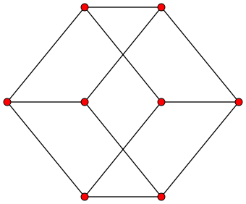
Weightless Neural Networks
In practice, it can be hard to devise a suitable mapping
Mapping some arbitrary set X to the set of bit strings of length r essentially means to assign each element to a vertex of the unit hypercube of dimension r
(1, 1, 0) “dog“
(0, 1, 0) “beetle“
(1, 0, 1) x
(0, 0, 0)
(0, 0, 1) “cat“

Slide 6
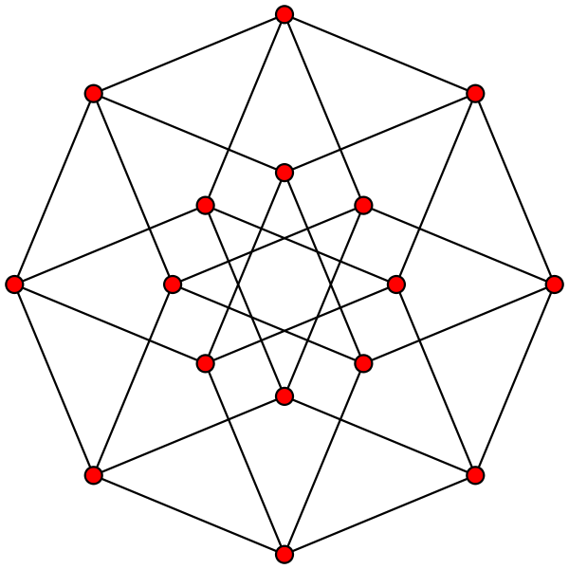
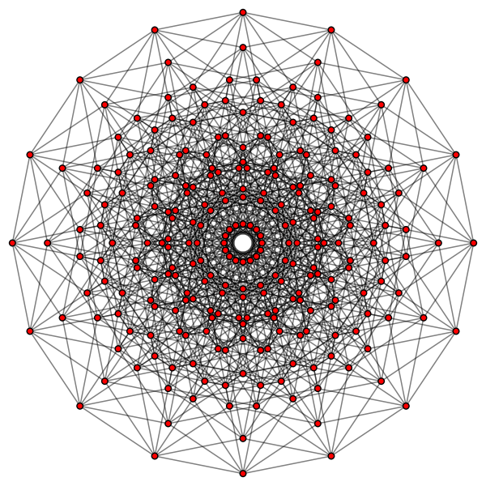
Weightless Neural Networks
As r increases, the number of distinct elements that can be represented grows, but so does the complexity of the space

Slide 7
Weightless Neural Networks
Increasing r also impacts a weightless neuron's response time: using a linear search algorithm, discovering the known input ik which is closer to x takes θ(rn), where r is the length of the bit strings and n the number of known cases
Therefore, the speed of weightless neurons is impacted both by the number of known cases they need to store in order to enable sufficient accuracy, and the length of the bit strings they use to represent inputs (i.e. the curse of dimensionality)

Slide 8
Weightless Neural Networks
Rather than a single neuron mapping relations between input and output sets, elements are broken down into features that are dispatched to different neurons for training
xk
bk,1
γ
W
α
bk,2
( , )
...
bk,1
gk,1
na
bk,m
( , )
bk,2
gk,2
nb
yk
gk,1
...
β
gk,2
( , )
...
bk,m
gk,m
nz
gk,m

Slide 9
Weightless Neural Networks
When recovering information from the network, returned features are assembled into an object from the output set
W
bk,1
na
gk,1
xk
bk,1
γ
ω
yk
α
bk,2
bk,2
nb
gk,2
...
bk,m
...
...
bk,m
nz
gk,m
It is from this need to split, group and assemble features across neurons that Weightless Neural Networks arise

Slide 10
Depth Map Estimation
Depth Map estimation is the process of deriving the distances from the viewer to elements in a scene
It can be done directly via a measuring device, e.g. a laser range scanner, or indirectly via an inference system, e.g. a stereo vision rig

Slide 11
Depth Map Estimation
Laser range scanners are often limited to a single horizontal or vertical band (1D)
Vision-based depth estimators can apprehend depth across the width and height of an image (2D)
Stereo vision rigs explore the disparity between images apprehended by each camera to estimate depth
This tends to work poorly for far objects and regions without texture
Monocular depth estimation can complement the input of stereo correspondence systems, improving its performance
It could also be used on its own, with the advantage of a simpler setup (e.g. no need to calibrate a camera pair)

Slide 12
Depth Map Estimation
Weightless Neural Networks can estimate depth maps for monocular images by learning relations between images and depth maps from a training database (which must therefore be constructed in some other way)
The advantage is that the trained system can run on a much simpler (and therefore cheaper) platform than the one required for acquiring the training data

Slide 13

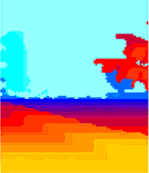
Depth Map Estimation
,
, ...
α, β, γ
W

Slide 14
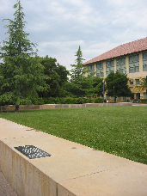
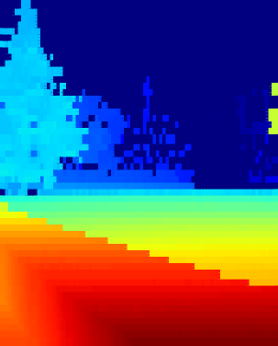
Depth Map Estimation
W
α, γ
ω

Slide 15
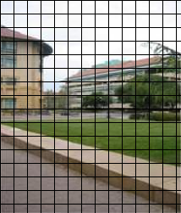
Depth Map Estimation
During training, images are divided in patches
A depth value is assigned to each patch
Pairs are assigned to neurons in the network for training
W
( , d1)
n1
...
( , dk)
ni
...
( , dn)
nz

Slide 16
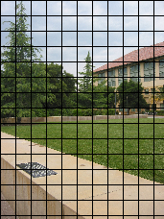
Depth Map Estimation
During testing, images are again divided in patches
Patches are dispatched to neurons, which return the closest associated depth values
Depths are collected and used to assemble a depth map
W
n1
ni
nz

Slide 17
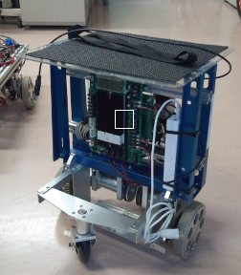
Visual Representations for WNN's
Each pixel in an RGB image takes 24 bits
A patch as small as 16x16 pixels contains 6144 bits
Curse you dimensionality!

Slide 18
Visual Representations for WNN's
Sampling can be used to avoid the curse of dimensionality
How the human visual system processes images?
  Photo-receptors are either Cones (which sense different color ranges) or Rods (which are only sensitive to light intensity)
  Photo-receptor distribution is dense inside the fovea, and more sparse elsewhere
  Retinal neurons record differences between a photo-receptor and its neighbors, not absolute values

Slide 19
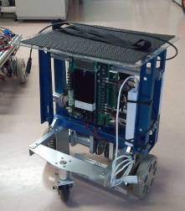
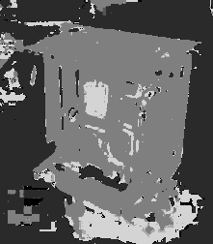
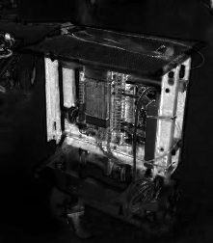
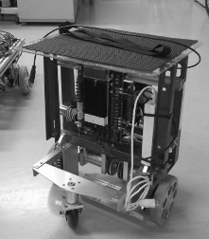
Visual Representations for WNN's
The channels of the HSL (Hue, Saturation, Lighting) color space provide an analogue to the separation of color and brightness information performed by retinal photo-receptors
H
S
L

Slide 20
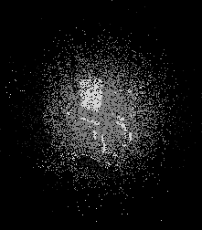
Visual Representations for WNN's
The distribution of photo-receptors across the fovea can be mirrored by sampling the image with a list of synapses {s1, s2, … , sk, … , sn} distributed in a Gaussian pattern

Slide 21
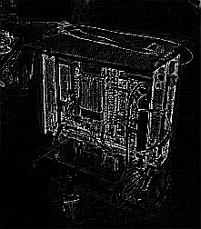
Visual Representations for WNN's
On-cells are simulated in two steps: first, an edge map is applied to the Lightness channel, adding a further projection to the input
H
S
L
Edges

Slide 22
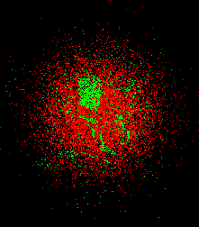
Visual Representations for WNN's
Second, minchinton cells are used to convert the numeric values reported by the synapses into single bits
A minchinton cell is formed by a pair of synapses (s1, s2)
It returns 1 if value(s1) > value(s2), and 0 otherwise
Out of n synapses, it's possible to form n minchinton cells {(s1, s2), (s2, s3), … , (sk, sk+1), … , (sn-1, sn), (sn, s1)}

Slide 23
Visual Representations for WNN's
The diagram below summarizes the resulting architecture:
RGB Image
Projections
H
S
L
Edges
Synapses
Minchinton cells
>
>
>
>
>
>
>
>
>
>
>
>
>
>
>
>
b
b
b
b
b
b
b
b
b
b
b
b
b
b
b
b
Input bit string

Slide 24
Visual Representations for WNN's
Sampling the previous projections using 1024 gaussian-distributed synapses (256 per projection), and converting their outputs to single bits using minchinton cells, produces a bit string of length r = 1024
The resulting 1024-bit representation of the image can now be used as input to a training weightless neuron, standing in place of the image's original (and much larger) content

Slide 25
Visual Representations for WNN's
10201114040012108208502601544100
8400009a800482082000814201092901
69d6a95dd54a52b2d3485531c9a8a53b
b24cb351a751b05156e2506978b4554d
51af36758a8ed9a99c268184cf356553
bca0db92a76ca2054557566eb8462d96
181245143a0a54298a6a8aba50111596
48511352ea54a90aa96405270e889a04
221x252 pixels
1,336,608 bits
1,024 bits

Slide 26

Network Architecture
Looking into depth maps, it's often the case that a stack of depth bands can be identified, where bands lower in the image mostly contain lower depth values, and higher ones, higher values

Slide 27

Network Architecture
This suggests a division in the neural network, where different neurons are assigned to specific bands in the image / depth map pair
N1
N2
N3
N4
N5
N6

Slide 28
Network Architecture
In order to add robustness to the system, each band is sampled by several neurons, each with its own unique synaptic layout
N1,1
N1,2
N1,3
N1,4
N2,1
N2,2
N2,3
N2,4
N3,1
N3,2
N3,3
N3,4
N4,1
N4,2
N4,3
N4,4
N5,1
N5,2
N5,3
N5,4
N6,1
N6,2
N6,3
N6,4

Slide 29
Network Architecture
During training, each (patch, depth) pair is dispatched to all neurons assigned to the horizontal band where it is located
N1,1
N1,2
N1,3
N1,4
N2,1
N2,2
N2,3
N2,4
N3,1
N3,2
N3,3
N3,4
N4,1
N4,2
N4,3
N4,4
N5,1
N5,2
N5,3
N5,4
N6,1
N6,2
N6,3
N6,4

Slide 30
Network Architecture
During training, each (patch, depth) pair is dispatched to all neurons assigned to the horizontal band where it is located
N1,1
N1,2
N1,3
N1,4
N2,1
N2,2
N2,3
N2,4
N3,1
N3,2
N3,3
N3,4
N4,1
N4,2
N4,3
N4,4
N5,1
N5,2
N5,3
N5,4
N6,1
N6,2
N6,3
N6,4

Slide 31
Network Architecture
During training, each (patch, depth) pair is dispatched to all neurons assigned to the horizontal band where it is located
N1,1
N1,2
N1,3
N1,4
N2,1
N2,2
N2,3
N2,4
N3,1
N3,2
N3,3
N3,4
N4,1
N4,2
N4,3
N4,4
N5,1
N5,2
N5,3
N5,4
N6,1
N6,2
N6,3
N6,4

Slide 32
Network Architecture
During training, each (patch, depth) pair is dispatched to all neurons assigned to the horizontal band where it is located
N1,1
N1,2
N1,3
N1,4
N2,1
N2,2
N2,3
N2,4
N3,1
N3,2
N3,3
N3,4
N4,1
N4,2
N4,3
N4,4
N5,1
N5,2
N5,3
N5,4
N6,1
N6,2
N6,3
N6,4

Slide 33
Network Architecture
During training, each (patch, depth) pair is dispatched to all neurons assigned to the horizontal band where it is located
N1,1
N1,2
N1,3
N1,4
N2,1
N2,2
N2,3
N2,4
N3,1
N3,2
N3,3
N3,4
N4,1
N4,2
N4,3
N4,4
N5,1
N5,2
N5,3
N5,4
N6,1
N6,2
N6,3
N6,4

Slide 34
Network Architecture
During training, each (patch, depth) pair is dispatched to all neurons assigned to the horizontal band where it is located
N1,1
N1,2
N1,3
N1,4
N2,1
N2,2
N2,3
N2,4
N3,1
N3,2
N3,3
N3,4
N4,1
N4,2
N4,3
N4,4
N5,1
N5,2
N5,3
N5,4
N6,1
N6,2
N6,3
N6,4

Slide 35
Network Architecture
During training, each (patch, depth) pair is dispatched to all neurons assigned to the horizontal band where it is located
N1,1
N1,2
N1,3
N1,4
N2,1
N2,2
N2,3
N2,4
N3,1
N3,2
N3,3
N3,4
N4,1
N4,2
N4,3
N4,4
N5,1
N5,2
N5,3
N5,4
N6,1
N6,2
N6,3
N6,4

Slide 36
Network Architecture
During testing, the m neurons on each band will output m estimates for each image patch; the value more often returned will be taken as the final estimate for the patch
N1,1
N1,2
N1,3
N1,4
d1
d2
d3
d4
dx
N2,1
N2,2
N2,3
N2,4
N3,1
N3,2
N3,3
N3,4
N4,1
N4,2
N4,3
N4,4
N5,1
N5,2
N5,3
N5,4
N6,1
N6,2
N6,3
N6,4

Slide 37
Network Architecture
During testing, the m neurons on each band will output m estimates for each image patch; the value more often returned will be taken as the final estimate for the patch
N1,1
N1,2
N1,3
N1,4
d1
d2
d3
d4
dy
N2,1
N2,2
N2,3
N2,4
N3,1
N3,2
N3,3
N3,4
N4,1
N4,2
N4,3
N4,4
N5,1
N5,2
N5,3
N5,4
N6,1
N6,2
N6,3
N6,4

Slide 38
Network Architecture
During testing, the m neurons on each band will output m estimates for each image patch; the value more often returned will be taken as the final estimate for the patch
N1,1
N1,2
N1,3
N1,4
N2,1
N2,2
N2,3
N2,4
d1
d2
d3
d4
dz
N3,1
N3,2
N3,3
N3,4
N4,1
N4,2
N4,3
N4,4
N5,1
N5,2
N5,3
N5,4
N6,1
N6,2
N6,3
N6,4

Slide 39
Current Results
For this sampling strategy and network architecture, the following parameters have been found to be optimal:
  Neurons: 10 per band
  Synapses: 256 per neuron, gaussian distribution with σ = 40
The data base had the following characteristics:
  Set: 425 (image, depth map) pairs, indoors and outdoors
  Dimensions: images 1704x2272, depth maps 86x107
  Patch dimensions: 19x21
  Training set: 190 pairs (44%)
  Validation set: 94 pairs (22%)
  Test set: 141 pairs (33%)

Slide 40
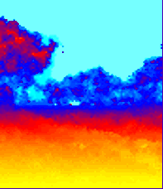
Current Results
Performance of the current architecture is encouraging (both indoors and outdoors) but limited
Estimation of a scene's general outlook is reliable, but finer details (in particular, close objects by the middle of the image) are often missed
Training is fast, but testing is gruesomely slow, taking as much as 10min for a single scene

Slide 41
Further Research
Several fundamental issues limit the current architecture's performance:
  The linear search algorithm employed by the neurons takes too much time and memory space
  The sampling strategy throws away too much information
  Distributing (patch, depth) pairs across neurons spatially (i.e. by horizontal bands) prevents the system from recognizing an object seen during training in a different band

Slide 42
Further Research
The current linear search algorithm is of complexity θ(rn) (for n bit strings of length r) in both time and space
In contrast, bitwise trie search takes θ(r) time when the exact input bit string is known, and θ(log(rn)) in the worst case where all bit strings have to be examined
As the number of known inputs increases, average search time goes down
Space complexity is θ(log(rn)); each new stored case takes a little less extra space than the previous one

Slide 43
Further Research
x = (1, 0, 1)
0
0
1
"cat"
1
1
0
"dog"
"dog"
d = 2
0
1
0
"beetle"
"cat"
d = 1
0
1
0
1
0
1
0
1
0
1
0
1
"cat"
"beetle"
"dog"

Slide 44

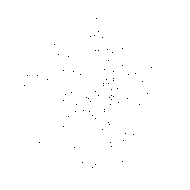
Further Research
Gaussian sampling images in the spatial domain provides no guarantee that the sampled points are expressive

Slide 45
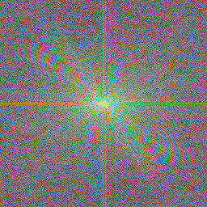


Further Research
Sampling a patch in the frequency domain yields a representation that is both compact and expressive

Slide 46
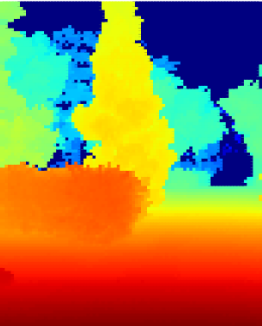
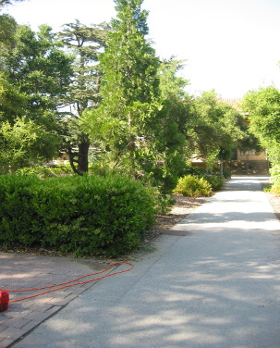
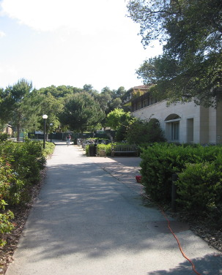
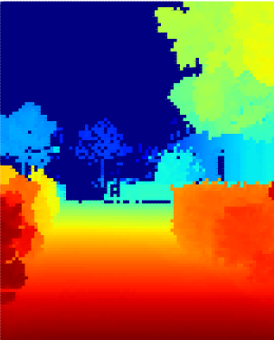
Further Research
Separating patches by spatial position limits the architecture's ability to generalize knowledge
Separating patches by visual features would avoid this restriction

Slide 47
Further Research
A "dispatcher neuron" can classify patches according to overall visual features, directing them to different "processor neurons" tuned to specific feature sets
N1
( , d1)
N2
...
N3
( , dk)
Nd
...
N4
( , dn)
N5
N6

Slide 48
The End
Questions?

